Slide 1
caGrid User Group – July 2009
July 16, 2009
caGrid Knowledge Center
https://cabig-kc.nci.nih.gov/CaGrid/KC

Slide 2
Agenda
Grid enabled image analysis of Tissue Microarrays, Tahsin Kurc, Emory University
caGrid Update
caBIG Annual Meeting Overview
KC: Upcoming Work and Requests
Open Floor
  Issues and Concerns
  What can the KC help you with?

Slide 3
Grid enabled Image Analysis of Tissue Microarrays (TMA)
Image Mining for Performing Comparative Analysis of Expression Patterns in Tissue Microarray
Tahsin Kurc
Center for Comprehensive Informatics
Emory University

Slide 4
TMA – Team
A joint project between the University of Medicine & Dentistry of New Jersey (UMDNJ) and Emory University.
Center for Biomedical Imaging & Informatics, The Cancer Institute of New Jersey
  David J. Foran
  Lin Yang
  Jun Hu
  Wenjin Chen
  Vicky Chu
Center for Comprehensive Informatics, Emory University
  Joel Saltz
  Tahsin Kurc
  Fusheng Wang
  Tony Pan

Slide 5
TMA – Project Objectives
Develop, deploy and evaluate a system that will support
  quick, reliable comparative analysis of expression patterns in cancer tissue microarrays,
  queries and comparisons across large datasets,
  discovery and retrieval of imaged tissue discs from within federated, "gold-standard" archives which exhibit expression patterns which are most similar to those of a given query disc.

Slide 6
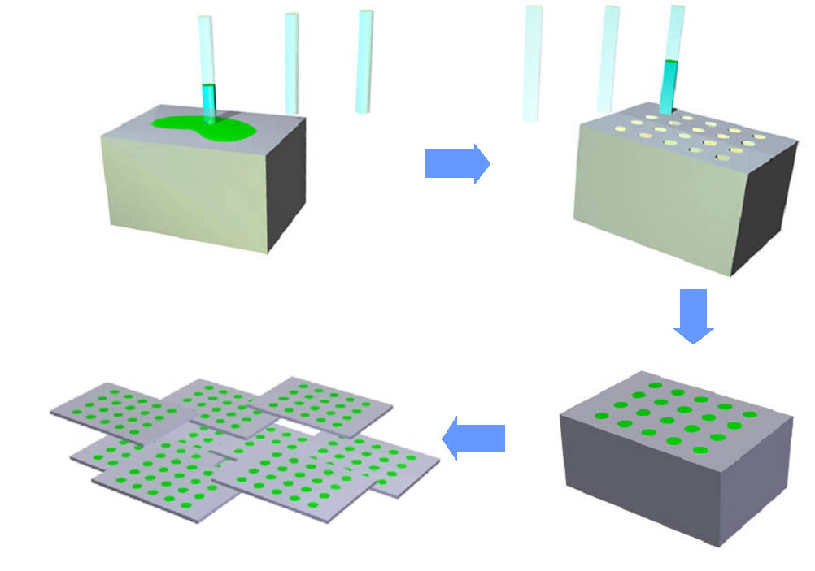
TMA - Overview
Tissue microarray (TMA) technique enables investigators to extract small cylinders of tissue from histological sections and arrange them in a matrix configuration on a recipient paraffin block such that hundreds can be analyzed simultaneously.

Slide 7



ImageMiner Grid
Architecture
caGrid TMA Data Service
caGrid TMA Analytical
Service
caGrid enabled
client program
Security Services
Dorian
Metadata Services
caGrid TMA Data Service
GTS
GME
caDSR
Grid Grouper
Authentication
Service
Index Service
EVS
caGrid TMA Analytical
Service
Higher Level Services
Workflow
Federated
Query Processing
Parallel Storage
System
Parallel
Computation
System
caGrid Coordination Services
caGrid TMA Data Service
caGrid TMA Analytical Service

Slide 8
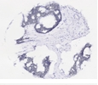
ImageMiner TMA Analysis Service
TMA Disc Images
caGrid Service
Mask Generator
Texton Histograms
Image Filter
Client
Texon Generator
Execute Analysis Tasks
Poster and Demo at caBIG Annual Meeting
Parallel Machine

Slide 9
TMA - Questions
Open floor for questions

Slide 10
caGrid Update
1.2.0.1 and 1.3.0.1 bug fix releases (7/10/2009)
Two maintenance releases of caGrid: version 1.2.0.1 and 1.3.0.1. Both are regression-tested cumulative updates that include numerous bug fixes, and are recommended for developers using the respective minor release (1.2.0.1 for 1.2 developers, and 1.3.0.1 for 1.3 developers). Please
see the release notes for a list of detailed changes.
1.2.0.1 Release Notes: http://gforge.nci.nih.gov/frs/shownotes.php?release_id=3411
1.3.0.1 Release Notes: http://gforge.nci.nih.gov/frs/shownotes.php?release_id=3410
Recommended for all users of caGrid 1.2 or caGrid 1.3
Updated software can be found at cagrid.org: http://cagrid.org/display/downloads/Home

Slide 11
caGrid 1.2.0.1 Highlighted Fixes (out of 23 fixes)
Introduce
13952 Error importing a schema that imports other schemas.
13968 Bug importing a schema that was already added but removed.
14757 Some UML / XMI models do not convert to DomainModel properly
14908 classnotfoundexception when deploying to tomcat 5.5+
19753 Introduce: Build: Post-processor: gov.nih.nci.cagrid.introduce.servicetasks.axis.FixSoapBindingStub does not process multiple services as defined within introduce.xml and introduce.properties
Data Services
18247 SDK 4.0 query processor can return duplicate object results
20921 caCORE SDK 4.0 Query Processor does not support queries against attributes of type java.lang.Float

Slide 12
caGrid 1.3.0.1 Highlighted Fixes (out of 3 fixes)
20520 Introduce gives no indication of a problem if an imported method's operation cannot be found in the imported WSDL
20921 caCORE SDK 4.0 Query Processor does not support queries against attributes of type java.lang.Float
21502 SDK 4.0 data service wizard doesn't correctly set domain model from caDSR

Slide 13
caBIG Annual Meeting Overview
caGrid Development Team
Posters:
  caGrid 1.3 Overview
  GAARDS
  Introduce
  OpenMDR
Booth
Presentations:
  Monday:
  caGrid Overview (Scott Oster)
  Security talk (Steve Langella)
  Arch Overview (Justin Permar)

Slide 14
caBIG Annual Meeting Overview (cont.)
caGrid Knowledge Center
Posters
  Knowledge Center
  Community Projects
  Grid Monitoring
Booth
Presentation
  Tuesday
    Deployment talk (Justin)
    caGrid Hack-a-thon (8PM): Analytical services with group-based authorization using Grid Grouper

Slide 15
caGrid Annual Meeting Hackathon
Focus: Analytical services with group-based authorization
Scenario: Grid-enabled Photo Sharing Application

Slide 16
KC: Upcoming Work
Security
  Fine-grained authorization in data services
    Using Grid Grouper
  caGrid Security Landing Page
    Comprehensive high-level grid security guide

Slide 17
Open Floor
What priorities do your projects have that the Knowledge Center can help with?
  Please post your suggestions to the caGrid Knowledge Center Suggestion forum or the caGrid User mailing list.
    https://cabig-kc.nci.nih.gov/CaGrid/forums/viewforum.php?f=21
    https://list.nih.gov/archives/cagrid_users-l.html

